Slide 1
Capstone business Intelligence solution for Netflix
Joseph Hand
Colorado state university-Global campus
Mis 480: Capstone- business analytics and information systems
Dr. orenthio Goodwin
12 March 2023
Notes:
Basic Introduction information on slide

Slide 2
Agenda:
TOPIC 1: Organization Background
TOPIC 2: Current Business Problem
TOPIC 3: Data Set Chosen
TOPIC 4: Business Intelligence tools
TOPIC 5: CODING
TOPIC 6: Description of Data Visualization Tools
TOPIC &: Data Analysis Outcome
REFERNCES
Notes:
Agenda set for the presentation Topics covered. Organization background, Current Business Problem, Data set chosen, Business intelligence tools , Coding, Description of data visualization tools used, Data analysis , and finally references.

Slide 3
Netflix Background Information
Netflix U.S. Based Organization
Found 1997
DVD by Mail
Streaming
Growth 1998 -Present
Notes:
Netflix is a US based organization that has a global reach. The company was founded in 1997 by Reed Hastings and Marc Randolph.
Initially, Netflix started as DVD-by-mail service, delivering DVD rentals to customers through mail. Then later chose to offer a wide range of movies, tv shows, documentaries and their own original content that could be streamed directly to various devices.
Initially, Netflix started as DVD-by-mail service, delivering DVD rentals to customers through mail. Then later chose to offer a wide range of movies, tv shows, documentaries and their own original content that could be streamed directly to various devices.
This year Netflix hit a new record for the registered members with more than 180 million accounts, 70 million from the United States alone

Slide 4
Current business problem
Customer base
Subscription from 1998 –Present
Competition
Netflix access issues
Subscription issues
Notes:
Netflix has been having issues from what I have read in articles throughout the past year when it comes to content and customer sharing. They will be actively trying to use the data that they collect to help make the decisions they need to help their business remain competitive and at the same time not lose revenue.
If Netflix continues to lose subscribers than they would be in serious trouble, competition in this area has been very tight and Netflix was once at the top. With more streaming services being offered subscribers may decide to leave Netflix all together. introduction, think about what context or background information the reader would benefit from knowing

Slide 5
Data set chosen for Netflix
Generated from Excel
Problems with Data Set
Notes:
Data set chosed for Netflix is generic. Information on customers Is hard to come buy.
To represent the large customer base a sample of data was take to get very general information l
Problems with Data is that it may not be an accurate snapshot of what Netflix currently uses.

Slide 6

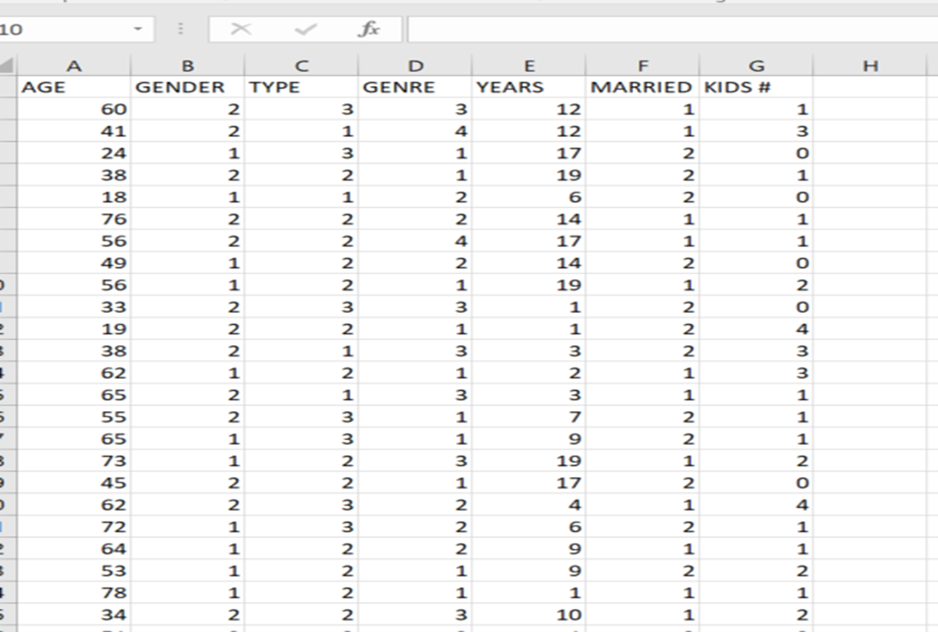
Data set imported to SAS
Notes:
I Imported my data set in to SAS with ease. SAS makes importing very easy I also labeled it under my current project for MIS 480
Here you can see this is a simple dataset. Mostly to help give a proper explanation for the data analysis we intended.

Slide 7
Summary statistics using Excel
Notes:
Excel has data analysis features also . This is a snap shot of the data set using excel. The variable are AGE , GENDER , Type (TV, Movie, Documentary) Genre (Comedy, Drama, Horror Suspense), Married or Single and Number of kids in house.

Slide 8
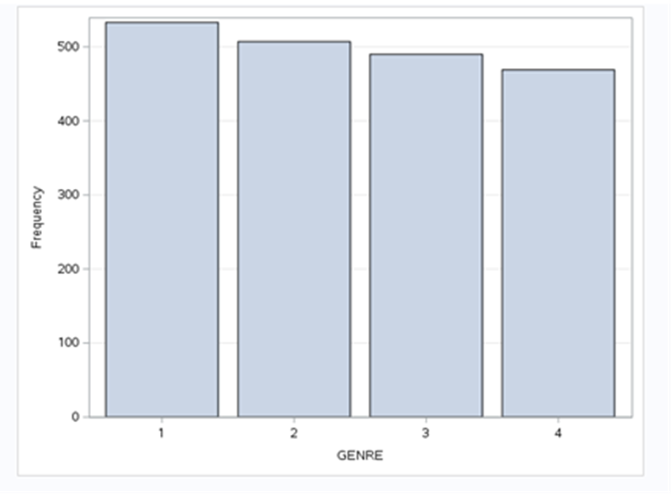
Frequency distribution of Genre types in Netflix
Notes:
Frequency of Genre types in Netflix that are often watched. 1 Drama , 2 Comedy, 3 Horror, 4 Suspense. Her we see the histogram move from 1 to 4 with Dram being the most popular. But all followed behind closely.

Slide 9
Box chart o age groups
Notes:
What is a Boxchart_ Is a way of graphically depicting groups of data through their quartiles. It provides a visual representation of statistical data based on the Minimum, first quartile, median third quartile and Maximum.
This shows the Minimum at 18 years old. The first quartile at 40 the average around 48 and the third quartile at 62. The fourth quartile is 80 years old. This shows the ages of subscribers.

Slide 10
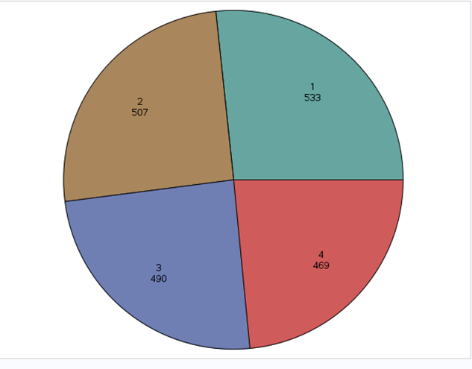
Pie Chart
1 Drama content
2 Comedic content
3 Horror Content
4 Thriller Content
Notes:
This Pie chart denotes the content that is mostly watched by the viewers.

Slide 11
Business intelligence tools
Benefits of BI Tools
Benefits tool used

Slide 12
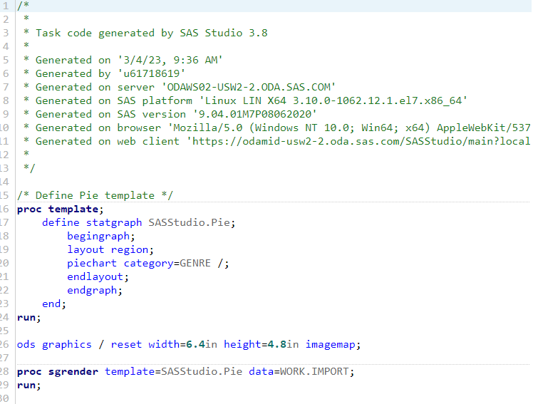
Code generated using SAS

Slide 13
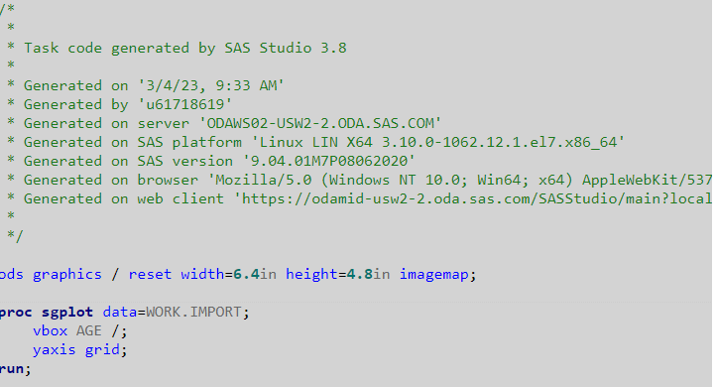

Slide 14



Description of data visualization tools

Slide 15
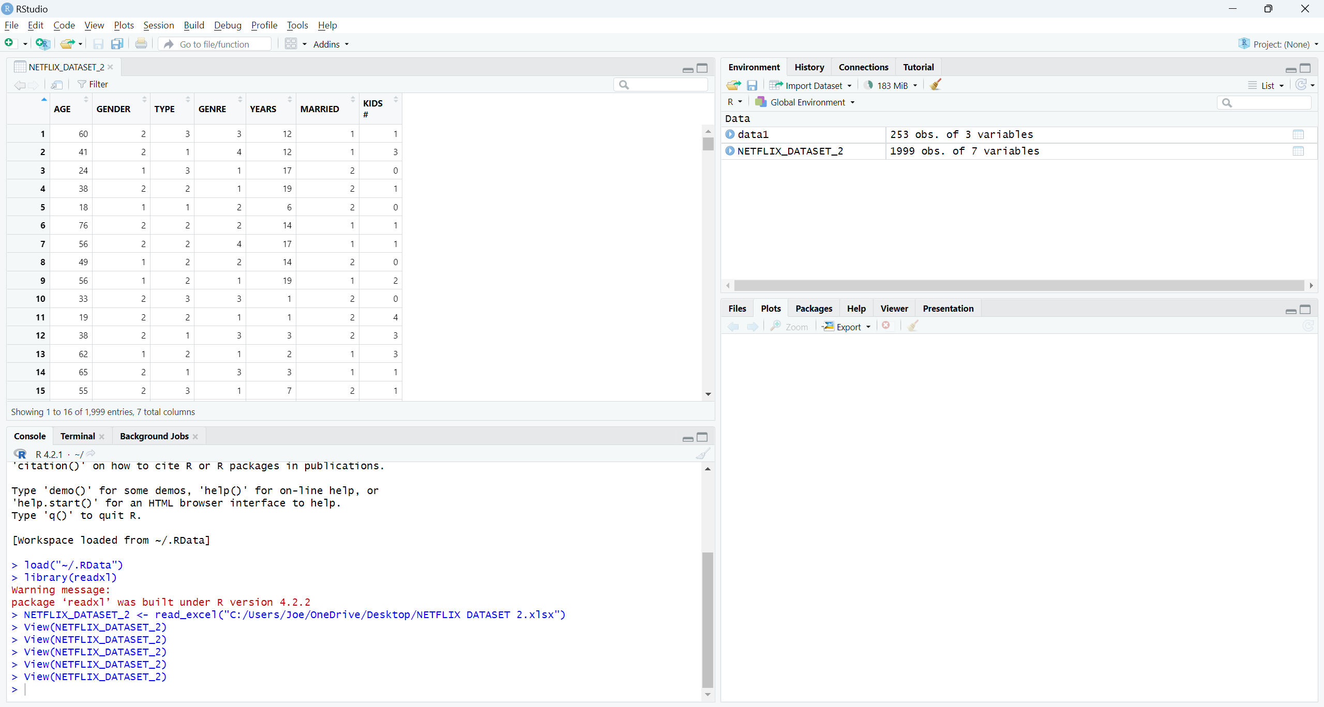
Data analysis outcome

Slide 16
Git Hub upload
Notes:
Git Hub uploaded of project

Slide 17
references
Datta, S. (2020, September 23). What led Netflix to shut their own data centers and migrate to AWS? Medium. Retrieved February 15, 2 https://shirshadatta2000.medium.com/what-led-netflix-to-shut-their-own-data-centers-and-migrate-to-aws-bb38b9e4b965#:~:text=Netflix%20uses%20AWS%20for%20nearly,100%2C000%20server%20instances%20on%20AWS.
McFadden, C. (2023, March 1). From dvds to streaming, Here's the incredible history of netflix. The evolution of Netflix: a long and fascinating journey. Retrieved March 11, 2023, from https://interestingengineering.com/culture/the-fascinating-history-of-netflix
Salesforce. (n.d.). Retrieved March 11, 2023, from https://www.salesforce.com/products/crm- analytics/overview
Sharma, K. (2022, May 28). 6 Ways Netflix uses the Power of Analytics. You are being redirected... Retrieved February 15, 2023, from https://www.ascentt.com/6-ways-netflix-uses-power-analytics/.
Sherman, A. (2022, July 18). Netflix investors brace for subscriber losses as company works on long-term fixes. CNBC. Retrieved February 15, 2023, from https://www.cnbc.com/2022/07/18/netflix-investors-brace-for-subscriber-losses-as-company-builds-for-long-term.html. concept analysis. Journal of Advanced Nursing, 71(8), 1787–1796. https://doi.org/10.1111/jan.12654
Notes:
References; Used.

